Slide 1

Thesis presentation
Degree: Joint Master of Science in Hydroinformatics and Water Management
Tampere, August 21st, 2019

Slide 2


Urban sanitary sewer modelling in cold climate
Test case using automatic calibration and precipitation forecast in Finland
Pedro Paulo Almeida Silva
Institutional tutor Dr. Frank Molkenthin
Institutional tutor Dr. Markus Sunela
2
Notes:
Sanitary sewer is the network of pipes used to transport the sewage from houses, industrial or commercial buildings to a disposal point such as the wastewater treatment plant

Slide 3
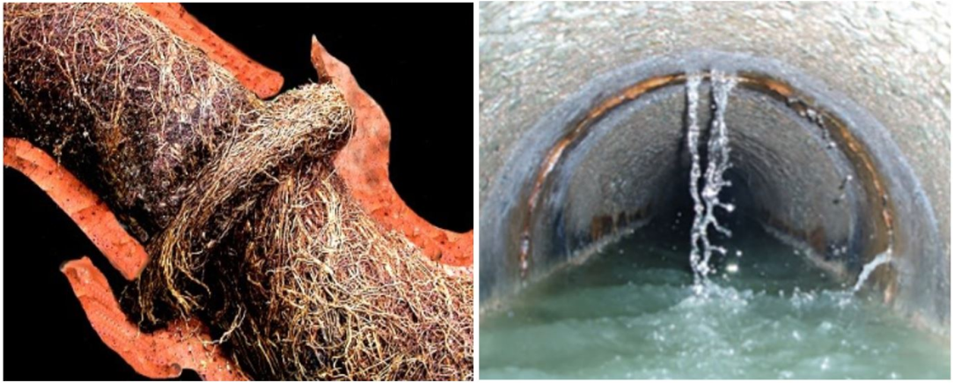
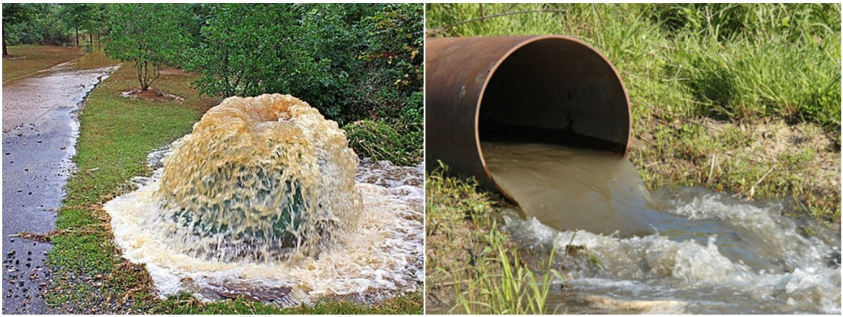
Problem description
Rainfall dependent Inflow and infiltration (RDII).
Inflow – roof or foundation drain connections. Infiltration – pipe cracks, faulty manhole, etc.
Overflows upstream caused by blockage or downstream by the WWTP bypass.
Why model the RDII? Improve design, rehabilitation, operations.
How can RDII be modeled in cold climates? Snow accumulation and snowmelt.
Root intrusion
[1]
Infiltration through cracks
Overflow: upstream
Overflow: downstream
[1]
[2]
[3]
Notes:
During wet weather conditions an extra volume of water inflows and infiltrates the sanitary sewer network
Also known as RAINFAILL DEPENDENT....
through roof or foundation drain connections or defects in the network such root intrustions, cracked pipes or faulty manhole cover.
Inflows fast, infiltration slow
Overflows upstream such as manhole floods when the pipe network has a blockage before the disposal or overflows downstream when the wastewater is diverted to rivers or streams through a bypass in the WWTP that has its intake capacity exceeded.

Slide 4
Objectives of the thesis
1. Use two different hydrological modeling approaches in SWMM to simulate RDII
2. Methodology for parameter estimation and calibration of the hydrological models.
3. Hydrological + hydraulic model for a case study of a town located in the south Finland.
4. Forecasted precipitation data and key aspects for a forecasting system.

Slide 5
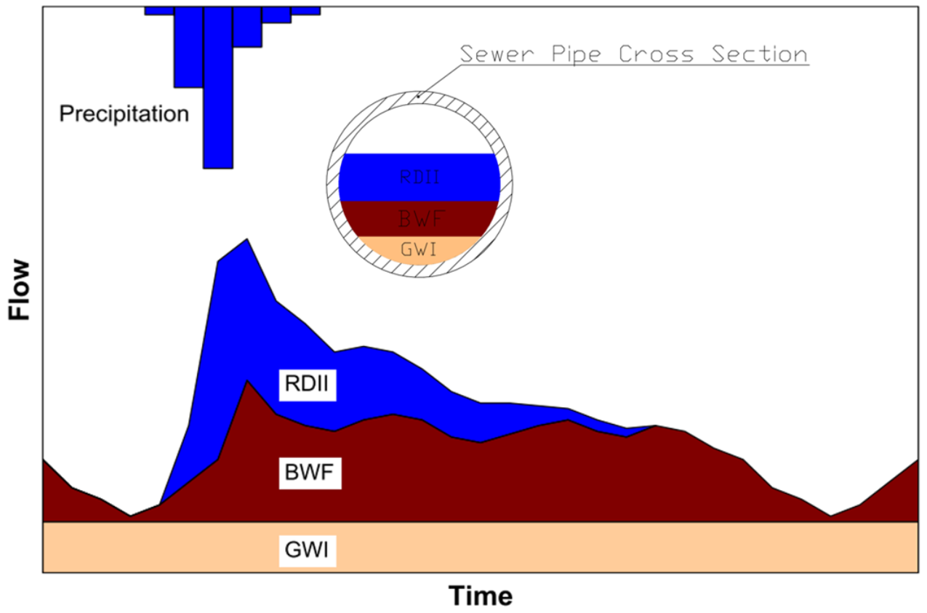

Wet-weather flow components
BWF + GWI = DWF
RDII + DWF = WWF
WWF ≈ 5 x DWF
RDII
WWF
Base waste flow
DWF
Groundwater infiltration
Wet-weather flow components in a sanitary sewer network. Modified from [5]

Slide 6
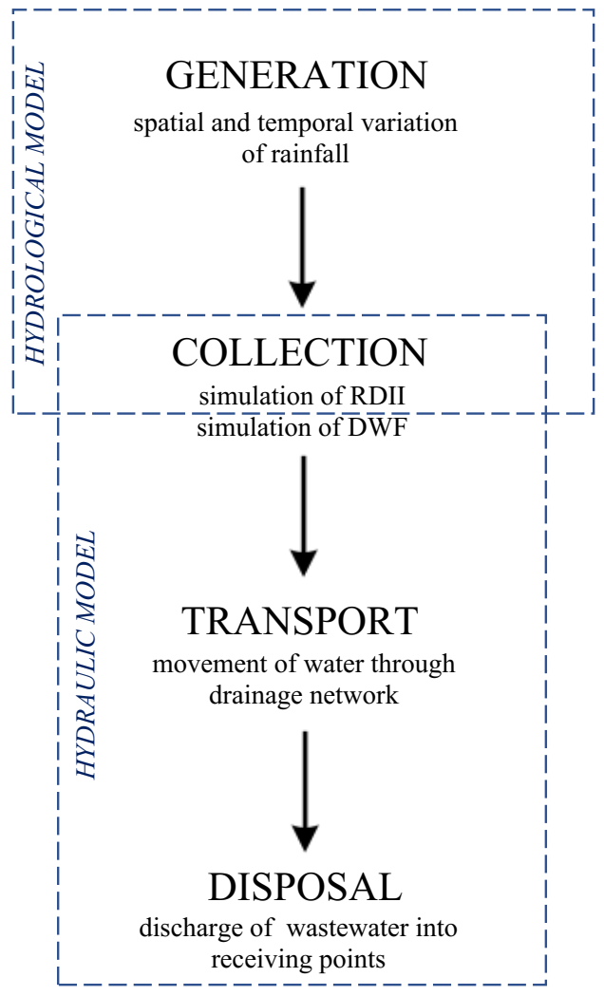
Methodology
Hydrological model
Generation
Collection
RDII
Hydraulic model
Collection
Transport
Discharge to a disposal point
DWF
Conceptual components of a catchment modelling system. Modified from [4]
Notes:
Use Hydrological and hydraulic model -> all components of SSN flow Hydrological model – Transform rainfall and snowmelt to hydrograph entering the system representing the RDII
Hydraulic model – DWF, routing and disposal

Slide 7
Division of the model set up
Offline model set up
Objectives 1, 2, and 3
Choice of hydrological model
Input data analysis
Coupling with hydraulic model
Parameter sensitivity and range
Calibration and validation
Online model set up
Objective 4
Routine for data acquisition
Continuous simulation
Routine for automatic calibration
Notes:
Model creation divided in two: The offline and online model set ups
Thesis objectives 1,2 and 3 are related to the offline model set up
Offline model set up – decision of the hydrological model to be chosen, data analysis and model set up (coupling with hydraulic model), analysis of the most sensitive parameters and their possible range and offline calibration and validation
Offline model set acts as a prerequisite for the online model where objective 4, the weather forecast, routine of data acquisition, initial conditions continuous simulation, and automatic calibration routine

Slide 8
Sewer model
Constant unit rate
Percentage of stream flow
Percentage of rainfall volume (R-value)
Probabilistic methods
Methods to model the RDII Bennett et al. [5]
Methods to model the RDII for a continuous simulation Bennett et al. [5]
Synthetic unit hydrograph
Rainfall / flow regression (2 years of data)
Methods chosen to model RDII in this study
RTK unit hydrograph
Physics-based model
SWMM
Notes:
Rainfall / flow regression – predictive equations based on rainfall/flow regression
Constant unit rate: based on the sewershed characteristics - > cubic meters per length, cubic meters per inhabitant, cubit meters per each land use type
Stream flow: can be used as a predictor of RDII because the combinations of hydrologic conditions that increase stream flow are similar to those that affect RDII entering a sewer system. Relationship can be developed between sewer flow monitoring data and stream-flow data
R-value: first analyze the flow monitoring data and estimate the volume of RDII, then compare with the rainfall volume to find the ratio.
Probabilistic: Recurrence interval of peak RDII flows - not useful for predictions.

Slide 9
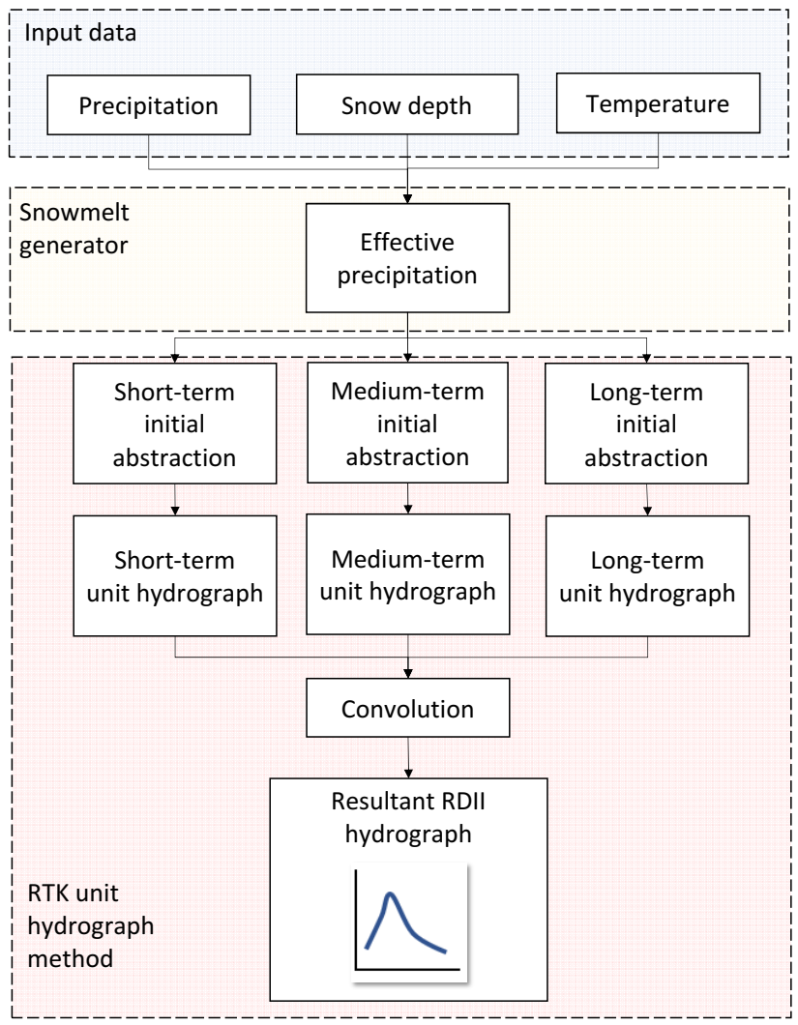
RTK unit hydrograph method
While precipitation = True
If (Temperature > 0,5°C): Add rainfall to effective prec.
Else: nothing #snow accumulation
Rainfall
Snowmelt
When snowdepth ^{t} < snowdepth ^{(t – 1)}:
snowdepth ^{t} x 0,1 #1cm -> 10mm
Initial Abstraction
Do [mm]
Dmax [mm]
RTK Unit hydrograph
Drec [mm/day]
Notes:
In addition to the unit hydrograph method
An estimation of the snowmelt was used based on precipitation, snow depth, and temperature measurements
Effective precipitation added to the optional initial abstraction

Slide 10
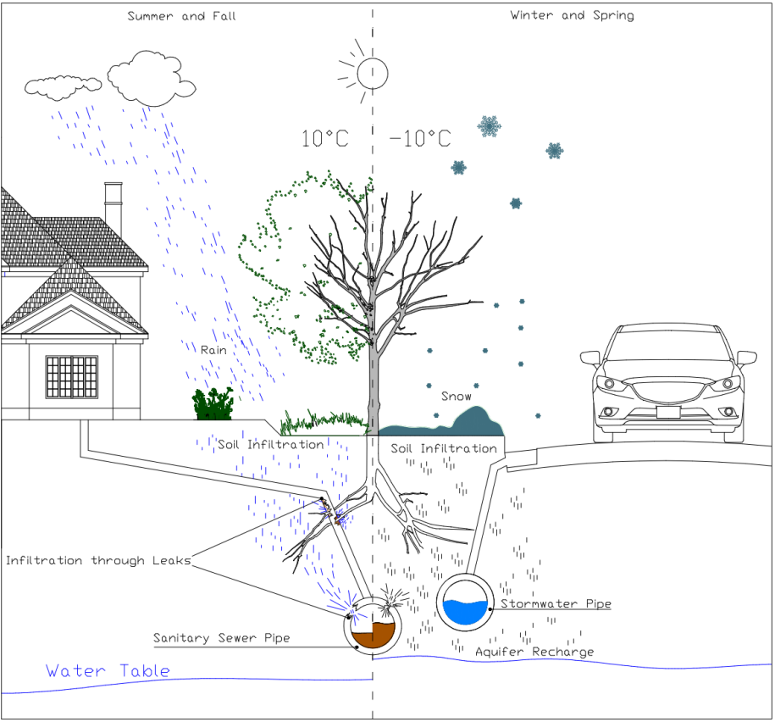
Physics-based model
Snowpack and snowmelt
Surface runoff
Infiltration (modified Horton)
Aquifer and groundwater flow

Slide 11
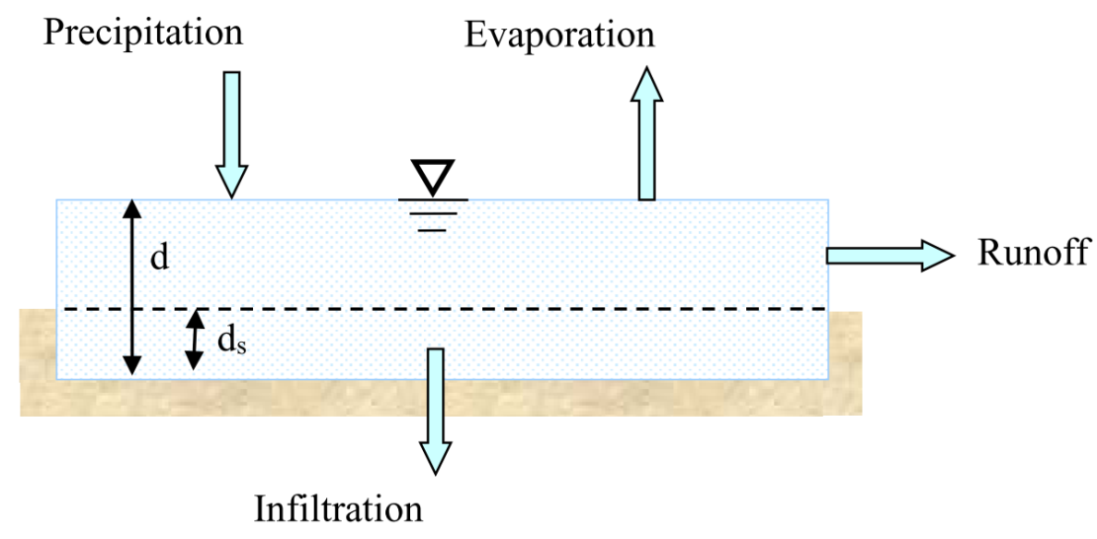
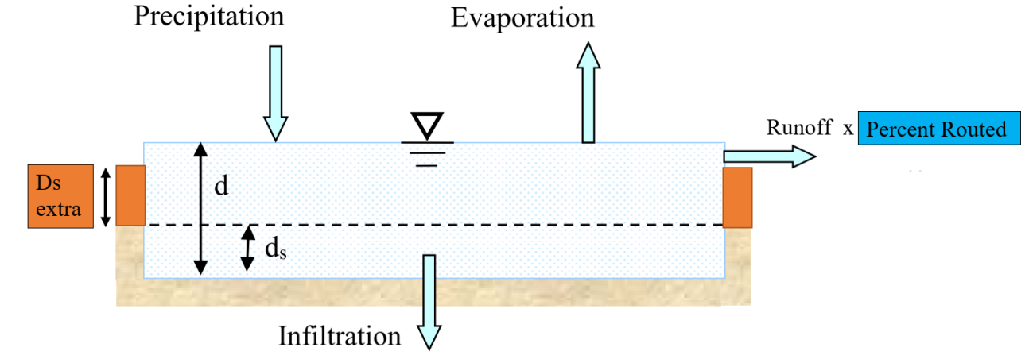
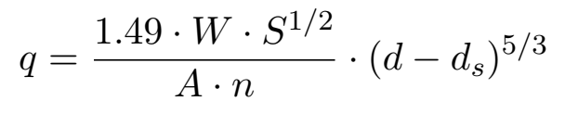
Physics-based model – conceptual adaptation for RDII Runoff
· 0,05
The other 95% is routed to the pervious area
Gauckler–Manning–Strickler formula
Notes:
The conceptial adaptations.

Slide 12

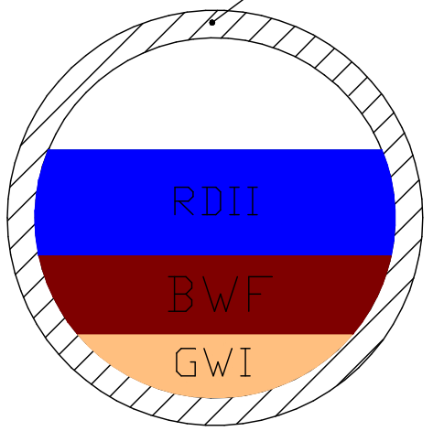

Physics-based model – conceptual adaptation for RDII Aquifer and groundwater flow
Aquifer
Less compact soil
Compacted soil -> low hydraulic conductivity
Notes:
Normally the aquifer bottom elevation is much lower than the elevation of the network pipes

Slide 13
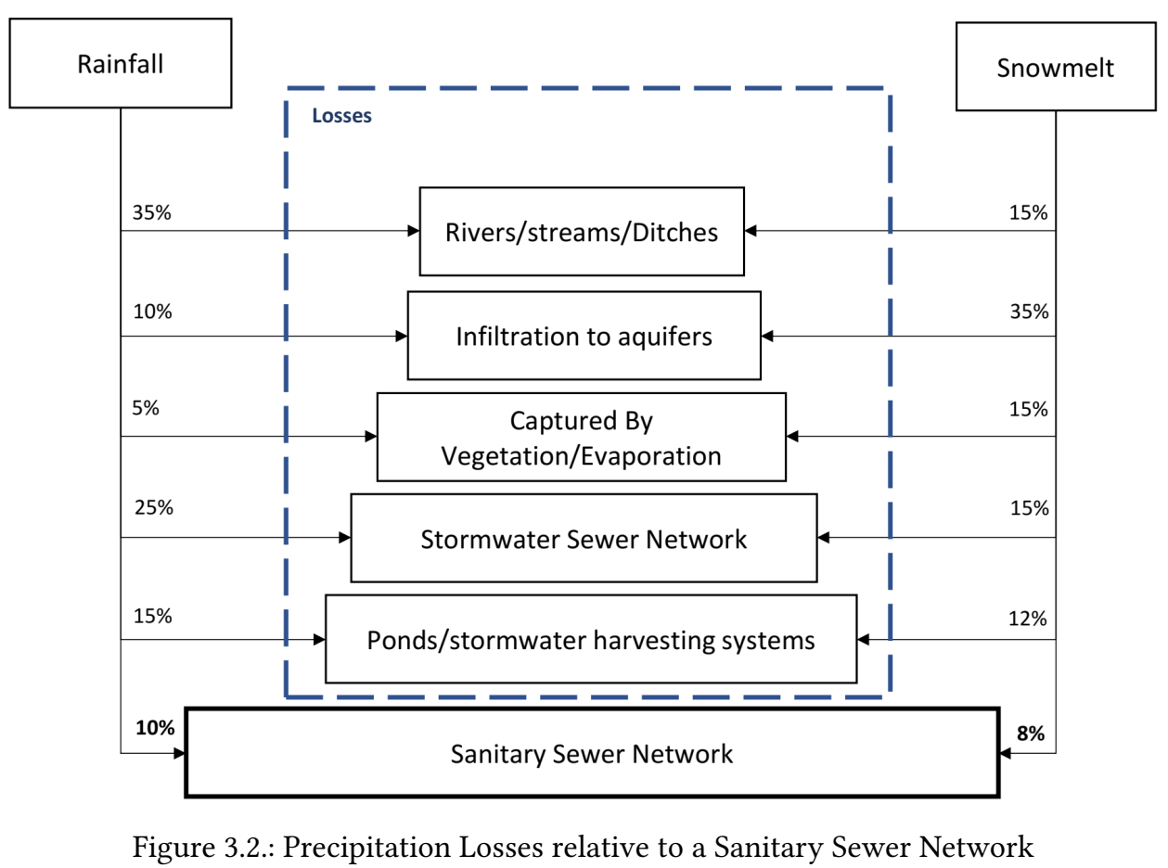
Losses
Physics-based
Unit hydrograph
Evaporation rate
Initial abstraction
Infiltration model
R-ratio
D storage
Percent routed
Seepage
Losses relative to a sanitary sewer network
Notes:
Parts of the rainfall and snowmelt water is lost before they find theirs way into the sanitary sewer network...
There are some ways to represent the loss in the physics-based model
Less ways to represent the losses for the unit hydrograph method

Slide 14
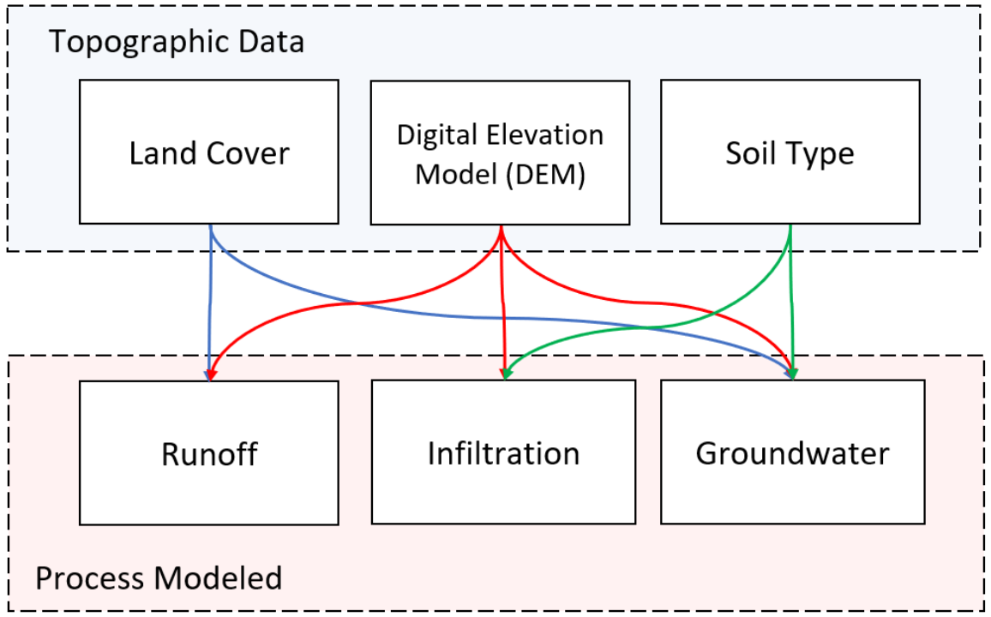
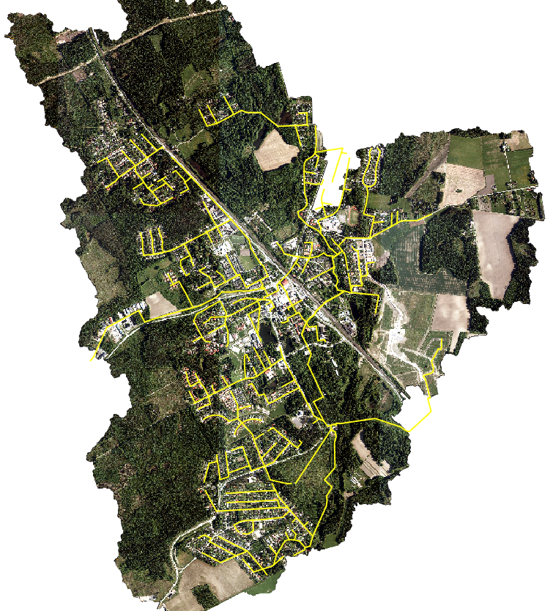
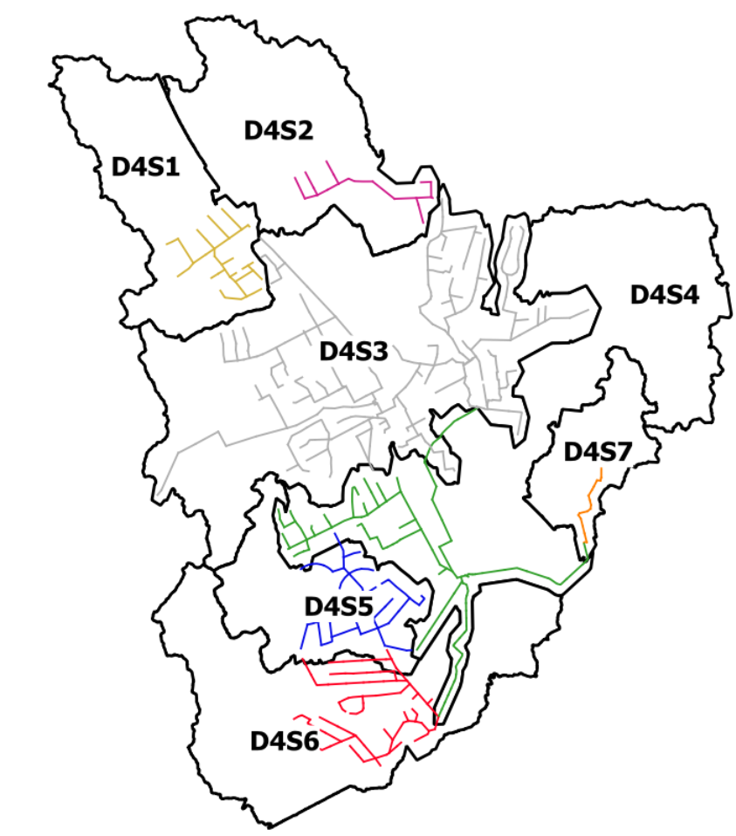
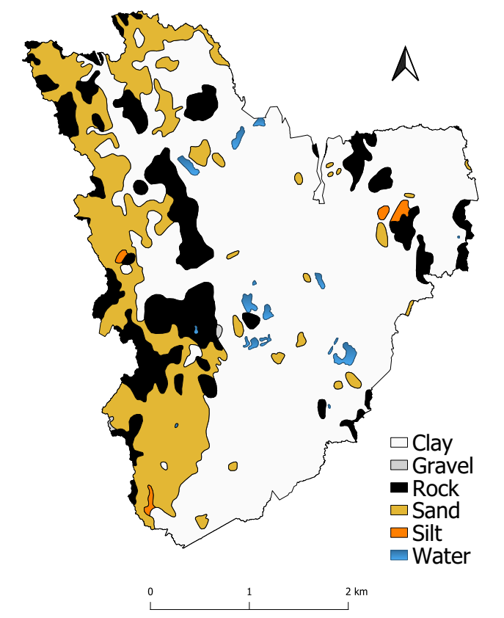
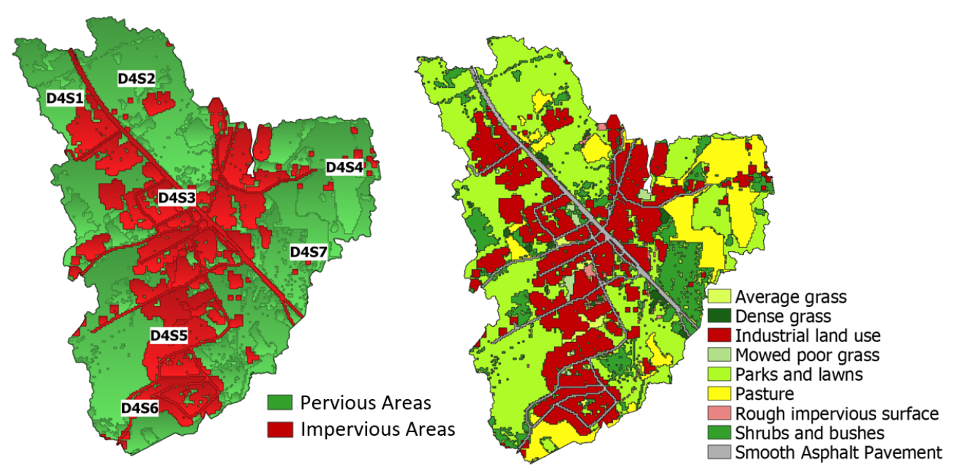
Topographic data and parameter estimation
6500 residents and 1550 DWF
Soil type: Clay and sand (86%)
3% average slope
Land use: ~ 30% impervious
Delineated area of 1355 ha
~ 47 km of network
Notes:
Tell about the location, case study of Jokela tow (6500 residents and 2975 buildings), area is rather flat with 3 % average slope. 43% of the catchment area is covered by semi natural or forests and 32 % by urban artificial surfaces. Soil type is mostly clay and sand (86%) network size, area delineated 1355 ha (equivalent to a sum of 1900 football fields), Catchment division per pumping station and why

Slide 15
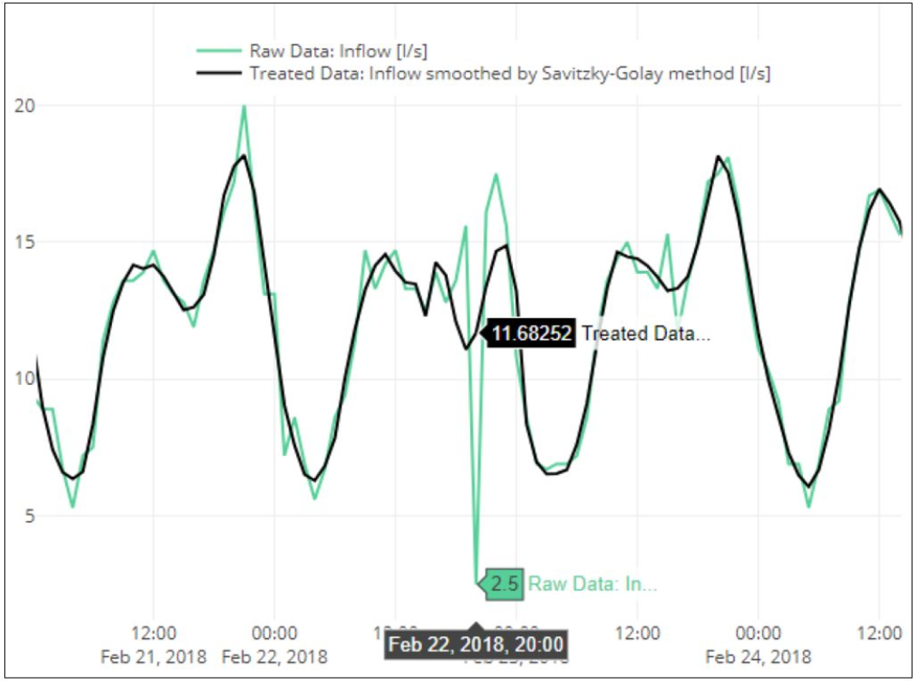
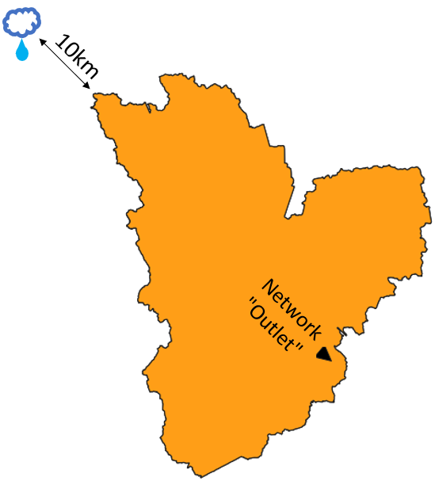
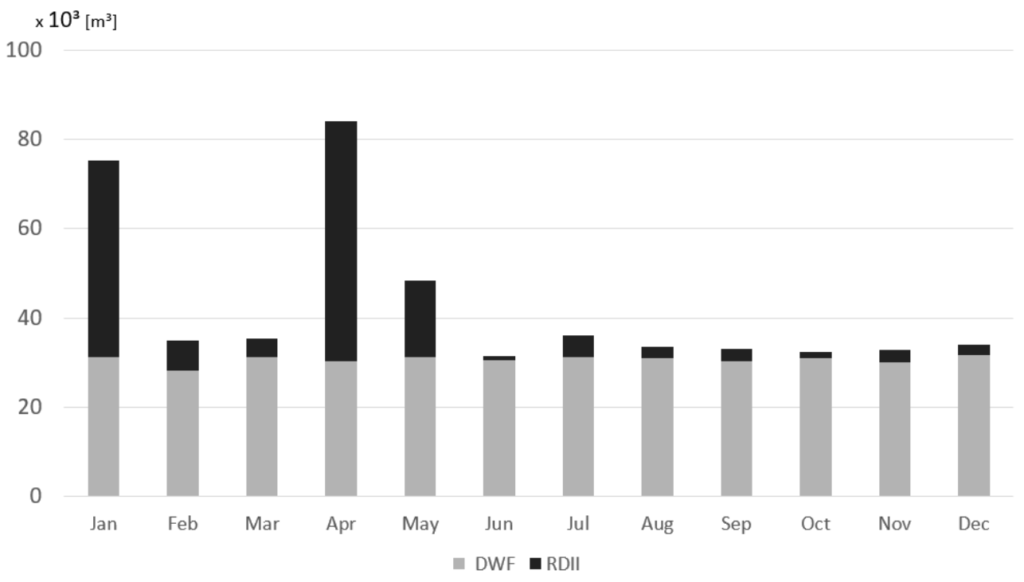
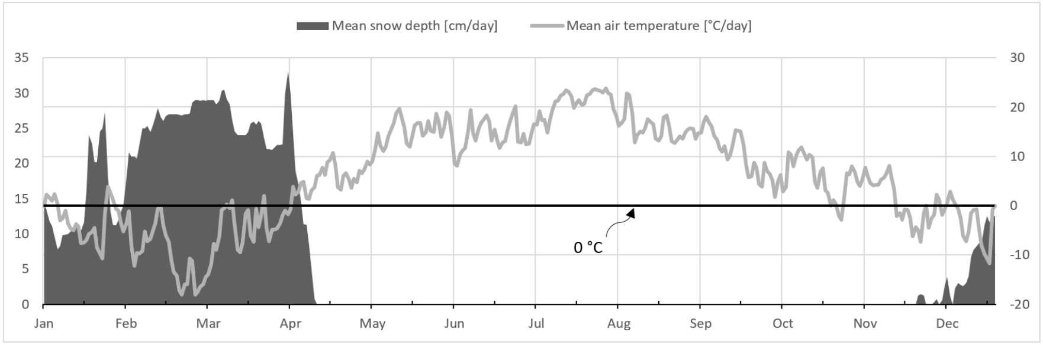
Meteorological and flow data
Python script to treat the sanitary sewer flow data
EPA SSOAP tool to estimate RDII 30% of RDII and 50% of RDII + GWI 88% of annual RDII between January and May of 2018
Historical meteorological data used: Precipitation, temperature, snow depth, evaporation, wind speed
Python script to fetch and parse forecast data from FMI’s and TMFG’s APIs
Notes:
Historical meteorological measurement point was located
Approx. 10 km away from the catchment

Slide 16
Calibration
Two seasons: Dormant and growth. One set of parameters calibrated for each season.
Physics-based
Unit hydrograph
Eight sensitive parameters found
Runoff: Percent routed Width
Aquifer: Seepage rate Hydraulic conductivity Hydr. Conduct. Slope A1 GWF coefficient
Snowpack: Min. melt coefficient Max. melt coefficient
From ~51 to 8
Manual calibration.
Dormant season: - Long-term simulation calibration for three events. - Snowpack and snowmelt routine active
Calibration using an optimization algorithm.
Dormant and growth season: - Event-based calibration. - Calibrated parameters averaged for each season
Growth season: - Event-based calibration. - Calibrated parameters averaged for the season - Snowpack and snowmelt routine inactive
Notes:
-Year divided in two seasons: winter and spring included in Dormant season. Summer and fall included in growth season
NSE is the nash suitcliffe coefficient where 1 means the perfect model and 0 means that the model is as good as the mean of the observed values. Flow measured at pumping station one was the only information used for the optimization algorithm, there was no information about measured values at pumping station two. Therefore the accuracy measured at pumping station two not necessarily increase with the number of iterations

Slide 17
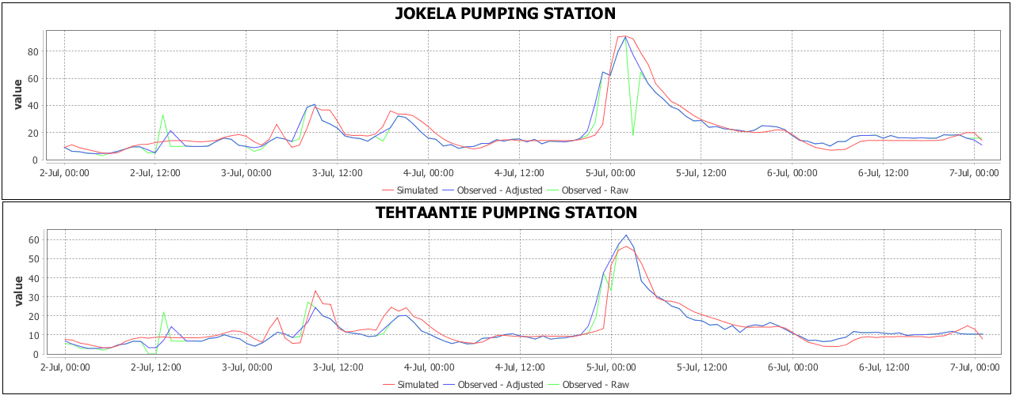
Calibration
PS2
PS1
Unit hydrograph 600 iterations
(PS1) NSE 0,86
(PS2) NSE 0,86
Notes:
Here is an example of the calibration results with parameters calibrated using the optimization algorithm
The optimization used only based on measured values for PS1
the pumping station two is located upstream.
This shows that quite good estimates can be obtained upstream the point used for the calibration.
This can be useful to estimate the flows on ungauged points of the network.

Slide 18
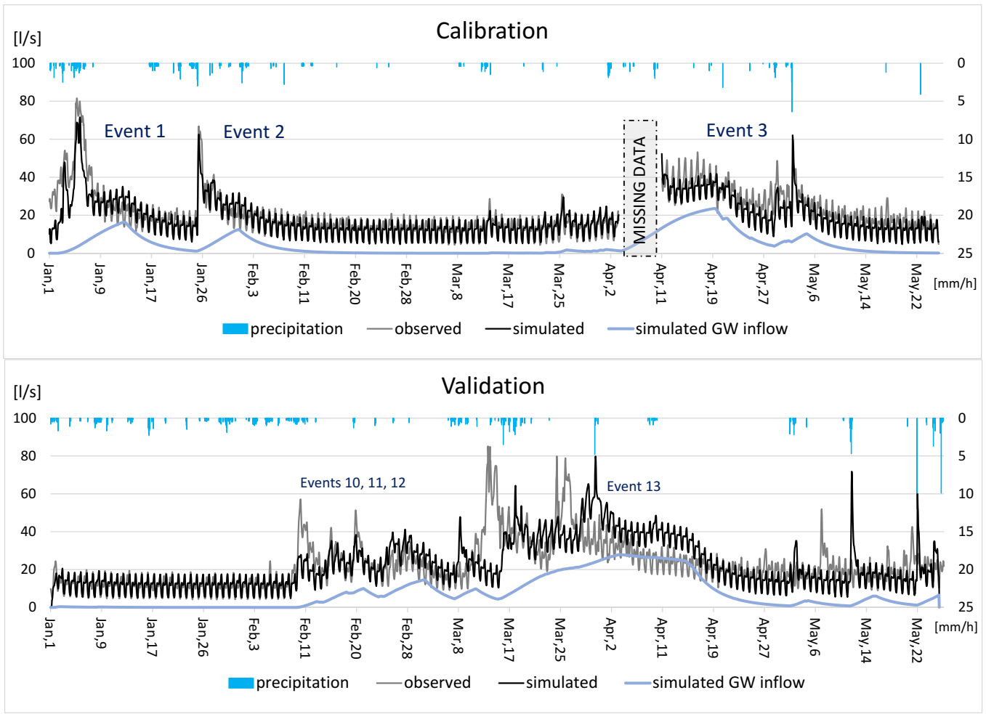
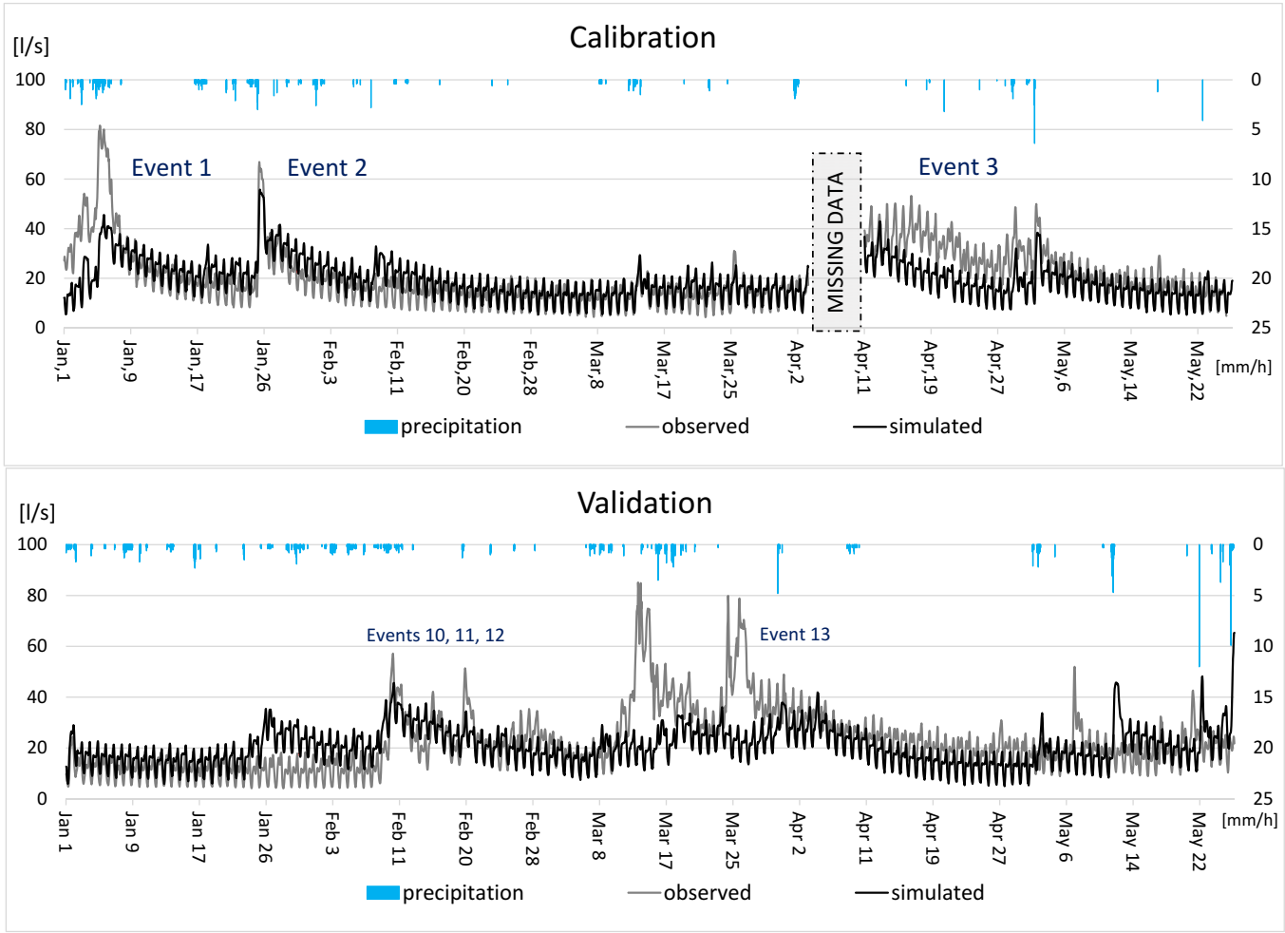
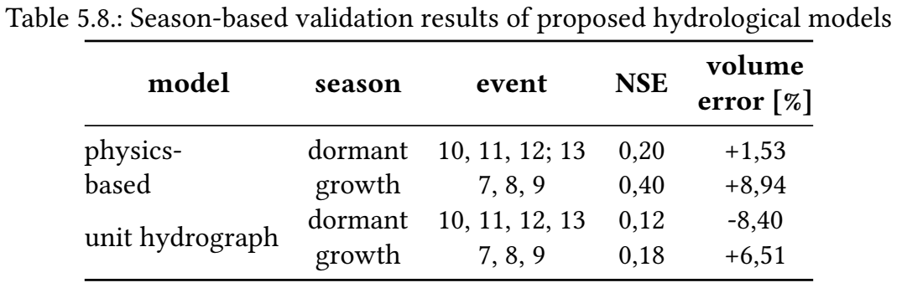
Dormant season – calibration and validation
Physics-based
Unit hydrograph
Notes:
Calibration was done with data from 2018 valitation done with data from 2019

Slide 19
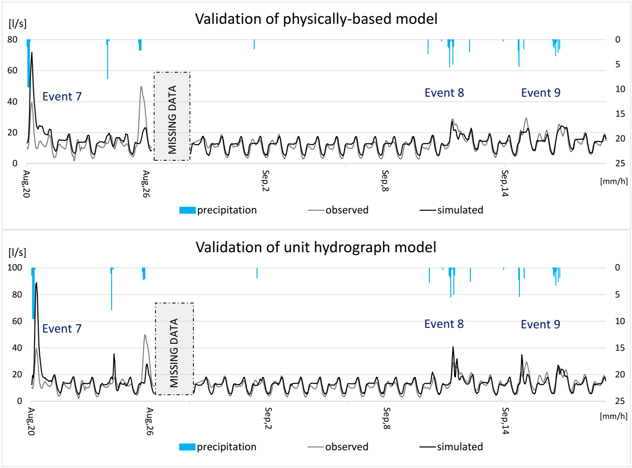
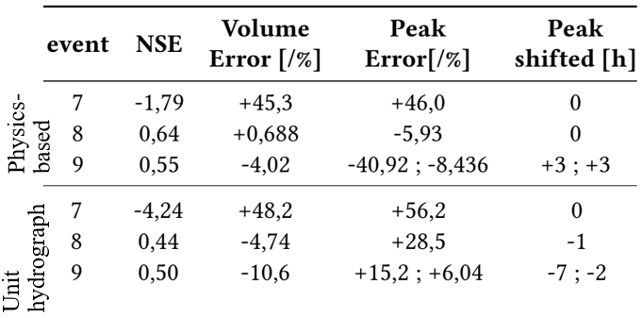
Growth season – validation
Event 7 overestimated
Peak after event 7 underestimated
Events 8 and 9 better simulated

Slide 20
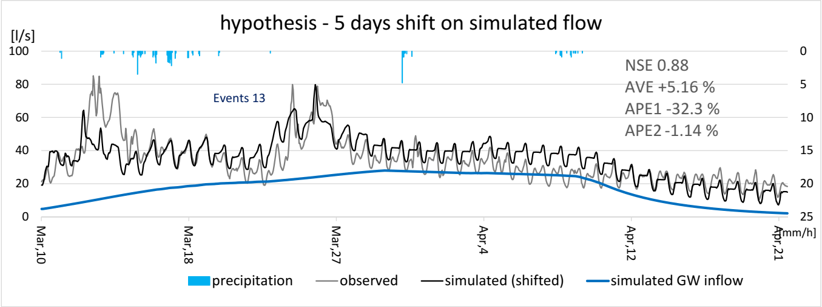
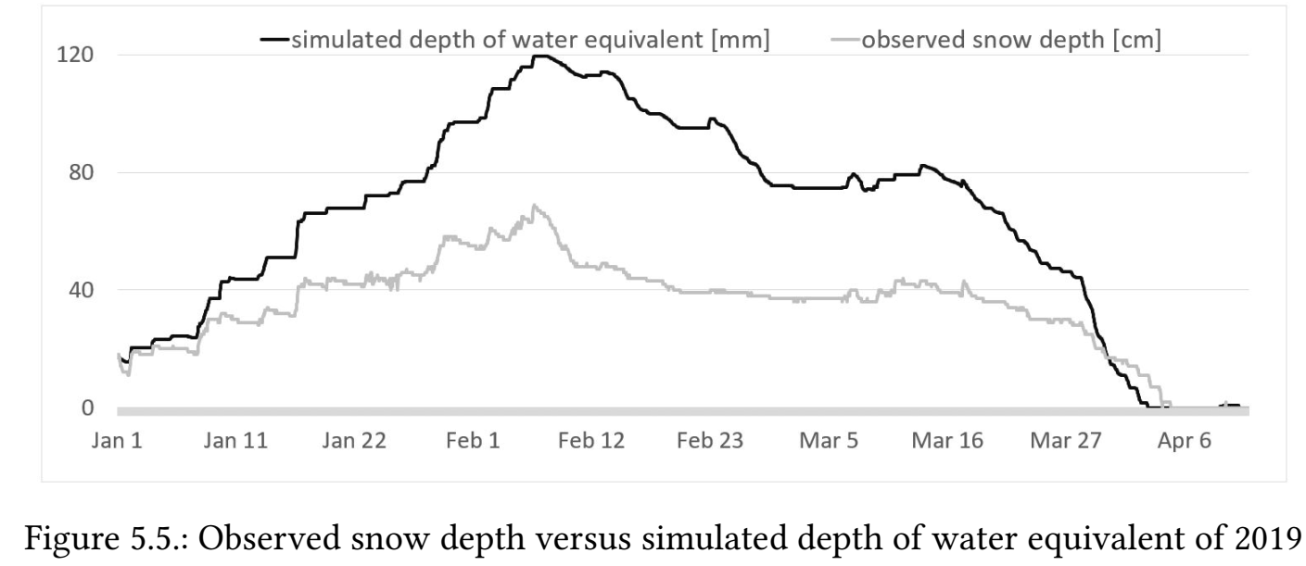
Hypothesis with validation results
Complete simulated snowmelt occurred even before than the observed
Depth of snow measured different than the real snow cover within the catchment? Was the temperature the same?
Notes:
Event 13 after the complete melt of the snow pack this year Hyp 1: parameters of the snowpack and snowmelt are different in different years
Hyp 2: temperature measured 10 km away is not representative of the actual temperature in the urban area of the catchment
2nd hyp seems to be more convincing since the model simulated the snowmelt in accordance with the measurements.

Slide 21
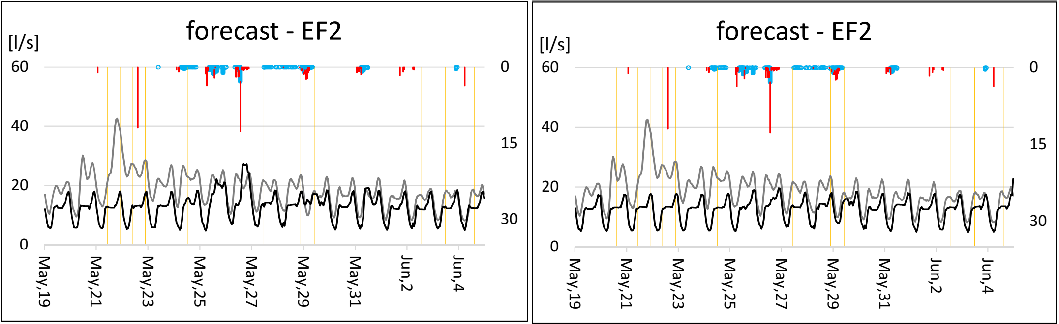
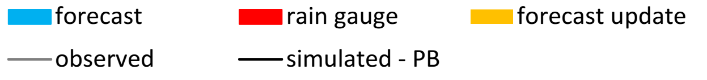
Preliminary results with forecasted precipitation
Physics-based
Unit hydrograph
Notes:
The simulated flows are obviously dependend on the precipitation forecast
The simulatied values are using the precipitation forecast (the blue bars) as inputs
Some events were not captured by the forecast, neither the rain gauge. Or was captured by the raingauge with a delay.
But some other events were ”correctly forecasted”. One of the events peak time was forecasted correctly even with 23h in advance.
It was possible to observe that the Initial volume in the system was underestimated, specially because this simulations were carried during the transition period

Slide 22
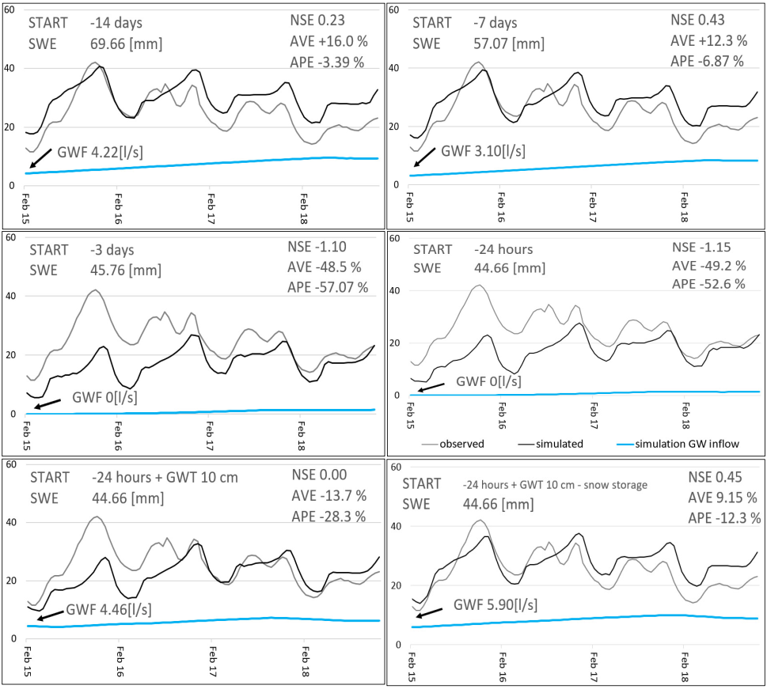
Six simulations with different initial conditions
Snow storage and groundwater table
For a forecasting system: Use of a hot-start file or a routine updating the initial conditions
Notes:
Six simulations were done using the physics-based model to assess the impacts of initial conditions
Critical initial conditions related to: Snow storage and groundwater table
Snow storage– snowmelt has to first fill the pores of the snowpack before it can runoff
For the online model a hot-start file which preserves the hydrological states prior to the current time or a routine to update the initial coditions based on measured data.

Slide 23
Conclusions
Both hydrological models can be used to simulate RDII in cold climates. The physics-based model performed better than the RTK model proposed in this study during the dormant season.
Methodology for estimation of parameters and their range seems to facilitate the model set up, calibration, and application for a near to real-time forecasting system.
The proposed snowmelt routine for the unit hydrograph underestimates the snowmelt volume. Variable ratio of snow depth and depth of water equivalent should be introduced.
The results are highly sensible to the meteorological inputs. Spatial distribution of the measurements affects the simulation results.
Reducing the number of parameters to be calibrated in the physics-based model can be considered an important step towards the utilization of an optimization algorithm.
Hot-start file or the update of initial conditions are also key aspects when implementing a forecasting system.

Slide 24
References
[1] | City of San Luis Obispo - CA. Sewer Lateral Pipe Material. URL https: //www.slocity.org/government/department-directory/utilitiesdepartment/wastewater/wastewater-collections/sewer-lateralpipe-material/.
[2] | Alan Cressler. Combined Stormwater/Sewage Overflow, Roswell, GA, Sept. 2009, 2009. URL https://www.usgs.gov/media/images/combined-stormwatersewageoverflow-roswell-ga-sept-2009.
[3] | Kimberly Davis. Solving Sewer Overflows Green Or Gray WERF Shows The Way, 2016. URL https://www.wateronline.com/doc/solving-sewer-overflowsgreen-or-gray-werf-shows-the-way-0001.
[4] | Kyung Sook Choi and James E. Ball. Parameter estimation for urban runoff modelling. Urban Water, 2002. ISSN 14620758. doi: 10.1016/S1462-0758(01)00072-3.
[5] | David Bennett, Reggie Rowe, Marie Strum, David Wood, Nancy Schultz, Kelly Roach, Mike Spence, and Virgil Adderley. Using ow prediction technologies to control sanitary sewer over-flows. Technical report, 1999.
[6] | Srinivas Vallabhaneni and Edward H Burgess. Computer Tools for Sanitary Sewer System Capacity Analysis and Computer Tools for Sanitary Sewer System. Environmental Protection, (October):1–104, 2007.

Slide 25
Thank you
Questions?

Slide 26
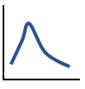
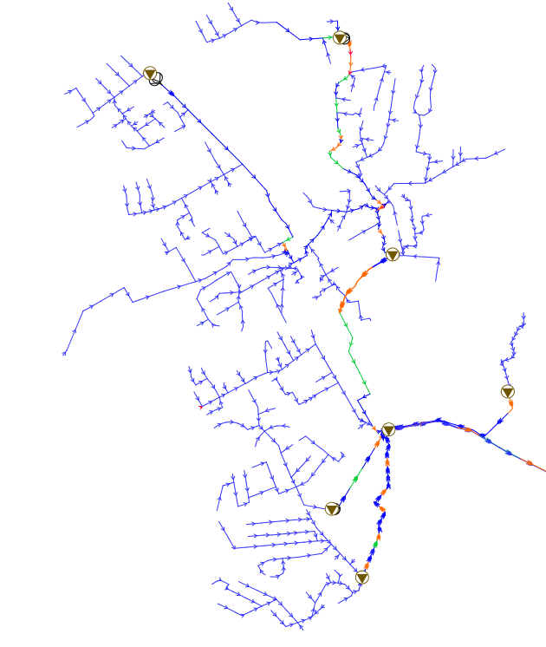
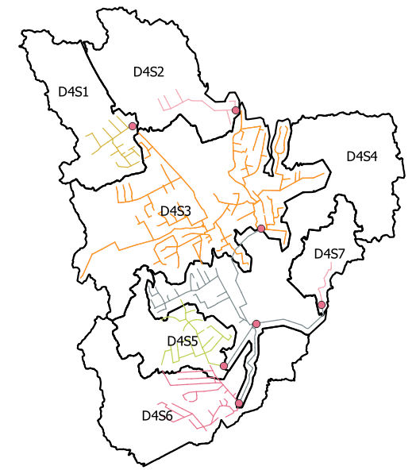
Case study
7 Pumping Stations
Measurements for 2018 in 2 pumping stations
Method 1:
Proposed 7 UH. One for each pumping station
Method 2:
7 subcatchments, one for each pumping station

Slide 27
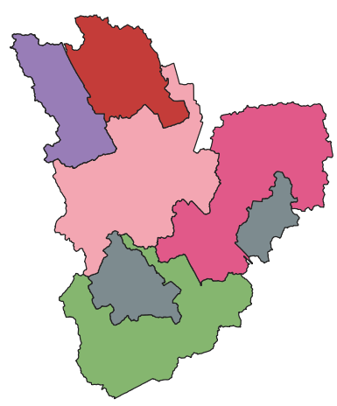
Parameters of each hydrological model
Physics-based
RTK unit hydrograph
Infiltration
SNOW PACK
Min Melt Coefficient (x3)
Max Melt Coefficient(x3)
Base Temperature(x3)
Frac. Free. W. Capacity(x3)
Initial Snow Depth
Initial Free Water
Depth at 100% Cover(x3) Total: 17
GROUNDWATER
Porosity Wilting Point Field Capacity
Conductivity
Conductivity Slope
Tension Slope
Upper Evap. Fraction
Lower Evap. Depth
Lower GW Loss Rate
Bottom Elevation
Water Table Elevation
Unsat. Zone Moisture Equation for GW flow
Total: 13
Inflow
Inflow
Infiltration
RUNOFF
Area
Width
Slope
%imperv
N-imperv
N-Perv
Dstore-Imperv
Dstore-Perv
%Zero-imperv
Subarea Routing
Percent Routed
Total: 11
Short-Term
R short T short K short Dmax short
Drec short
Do short
Medium-Term R medium T medium K medium Dmax medium
Drec medium
Do medium
Long-Term
R long T long K long Dmax long
Drec long
Do long
SNOW MELT
ATI weight Frac
Dividing Temp
Negative Melt Ratio
Elev. Above MSL
Latitude
Longitude correct
Total: 6
INFILTRATION
Max. Infil. Rate Min. Infil. Rate
Decay Const.
Drying Time
Total: 4
Optimization algorithm for calibration !
Total number: ~ 51
Total number: 18
Notes:
Around 50 parameters to be calibrated for each catchment for the PB
Around 18 parameters for the unit hydrograph
Infiltration (medium and long term portion of the wet weather flow hydrograph)
Inflow (short term portion)

Slide 28
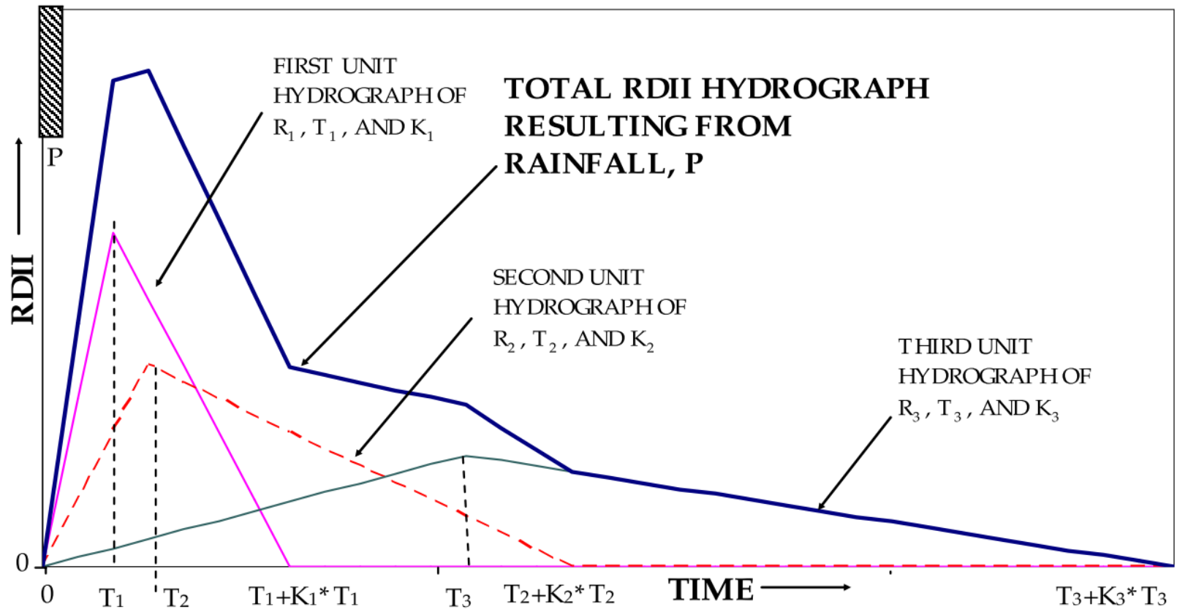
RTK unit hydrograph
Three triangular unit hydrographs First: short-term Second: medium-term Third: long-term
Three main parameters: R-T-K R: volume T: Time to peak K: Coefficient for recession limb
Resulting hydrograph
RTK method components for short, medium, long-term and resulting hydrographs [6]

Slide 29
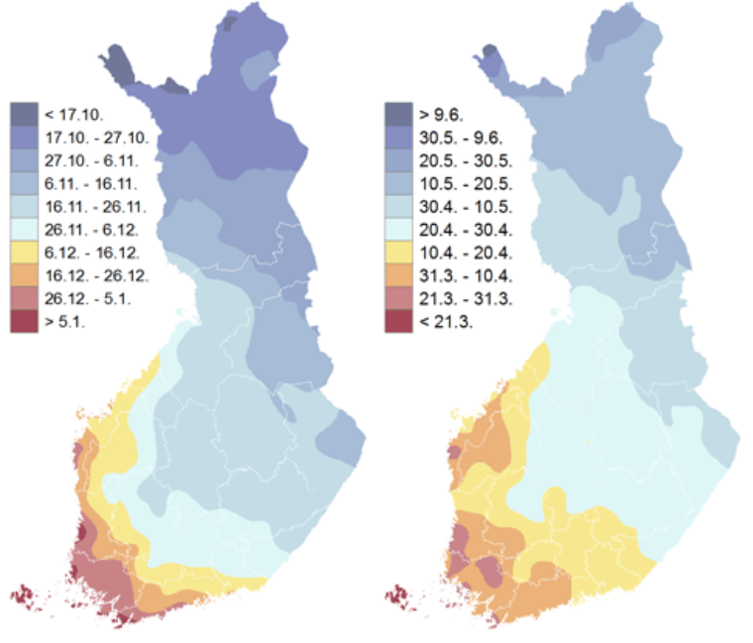
https://en.ilmatieteenlaitos.fi/snow-statistics

Slide 30
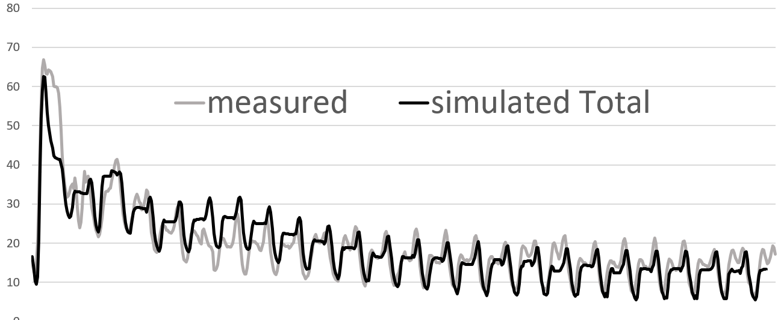
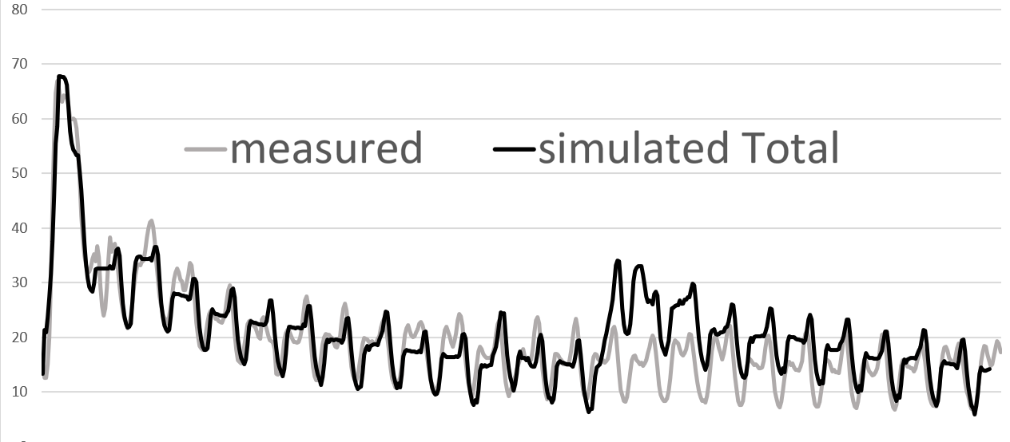
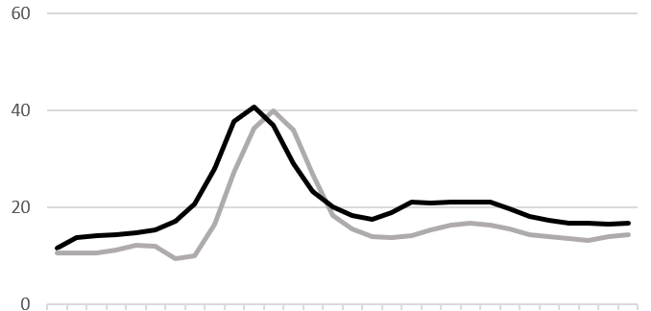
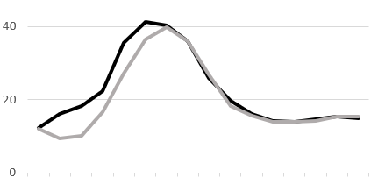
Calibration
Physics-based
Unit hydrograph
Dormant season
Dormant season
Growth season
Growth season
Notes:
Example of calibration results for one event of the dormant season and one of the growth season
- Overall better calibration results were obtained using physics-based model for the dormant season
Both models performed similarly for the growth season.
There were similar challenges for the calibration of both models to match the time to peak and the peak rate flow since both used the same precipitation information

